Slide 1
Turning Systems

Slide 2
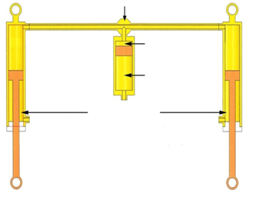
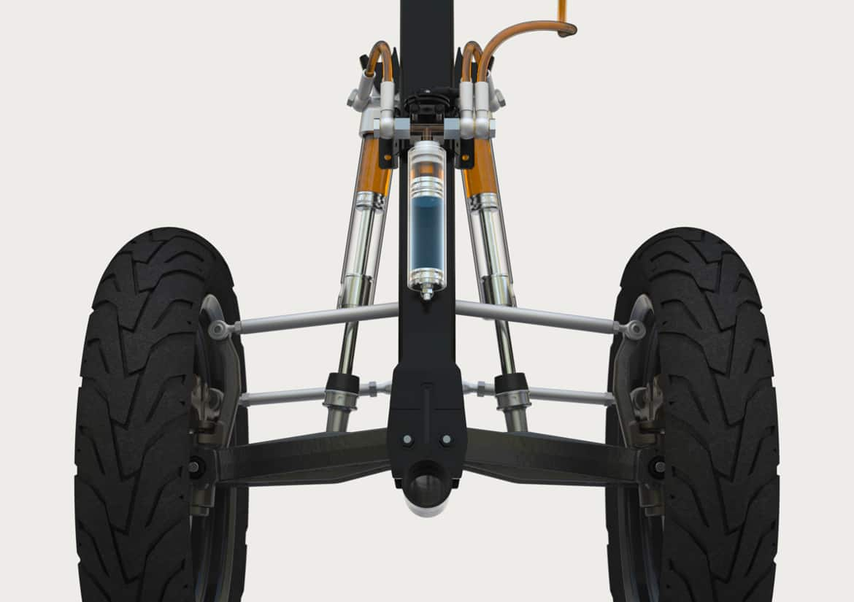
Hydraulic Tilting System
https://www.google.com/url?sa=i&url=https%3A%2F%2Fcommons.wikimedia.org%2Fwiki%2FFile%3AHTS_(Hydraulic_Tilting_System)_-_Details.png&psig=AOvVaw1wk5QzO-820JG7fCL583Ys&ust=1597808745461000&source=images&cd=vfe&ved=0CA0QjhxqFwoTCJDercrro-sCFQAAAAAdAAAAABAJ
https://www.google.com/url?sa=i&url=https%3A%2F%2Fmoto-station.com%2Fscooter-station%2Factu%2Fqooder-nouvelle-dynamique-quadro-vehicules%2F379651%2Fattachment%2Fhts-hydraulic-tilting-system-2017&psig=AOvVaw1wk5QzO-820JG7fCL583Ys&ust=1597808745461000&source=images&cd=vfe&ved=0CA0QjhxqFwoTCJDercrro-sCFQAAAAAdAAAAABAN

Slide 3
Hydraulic Tilting System
Pros
Cons
Will work according to our tilting standards
Implements Hydraulic systems (easier to understand after Richard’s lectures)
The idea can be implemented in a new configuration
The steering is not a wheel
No movement in the x-plane
Requires two wheels at the front
Hard to CAD
Technology is patented

Slide 4
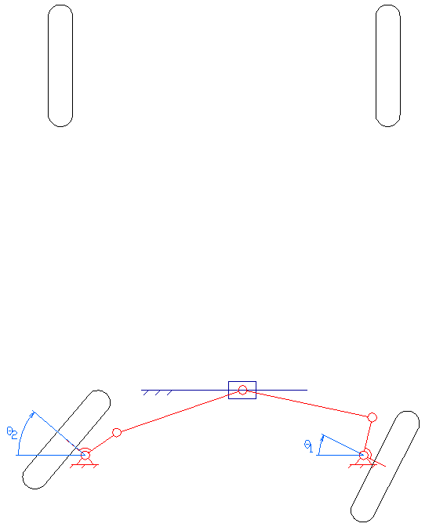
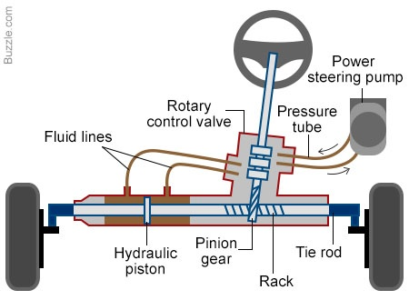
Rack and Pinion
https://globalautosol.com/2017/10/28/straight-narrow-power-steering-service/power
steering/https://en.wikipedia.org/wiki/Steering#/media/File:Short_rack_steering.gif

Slide 5
Rack and Pinion
Pros
Cons
Easy to implement
Easy to CAD
Easy to understand
Requires two wheels
Provides no tilt
Requires two wheels

Slide 6
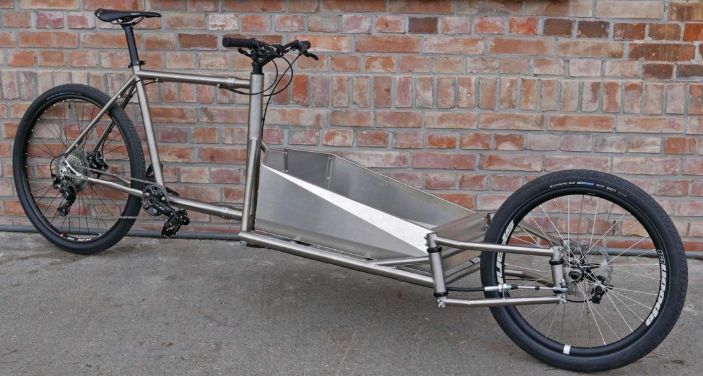
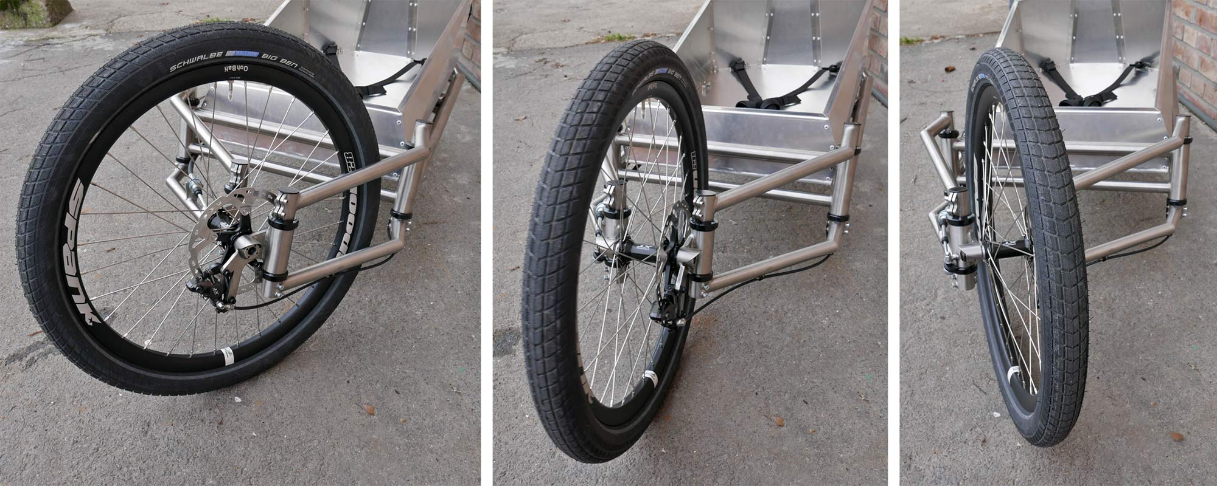
Not sure about name
https://bikerumor.com/2019/03/11/catan-titanium-cargobike-corners-like-no-other-with-light-comfortable-ride/

Slide 7
Previous one
Pros
Cons
Works with one when in the front
Easy to understand
Easy to CAD
Doesn’t have a steering wheel
Doesn’t tilt
Doesn’t incorporate hydraulics
Is a manual system

Slide 8

Hybrid between the last 3 systems

Slide 10
+

Slide 12
+

Slide 14
Resources
https://en.wikipedia.org/wiki/Tilting_three-wheeler#Wheel_layout
https://bikerumor.com/2019/03/11/catan-titanium-cargobike-corners-like-no-other-with-light-comfortable-ride/
https://rqriley.com/the-dynamic-stability-of-three-wheeled-vehicles-in-automotive-type-applications/
https://www.youtube.com/watch?v=em1O8mz7sF0

